Slide 1
Employee Data Analytics using Excel
STUDENT NAME: Archana S
ROLL NO: 22BC10
REGISTER NUMBER: 312218920
NAAN MUDHALVAN ID: 8A321CBC9EB252488DD43E00CCBA575E
DEPARTMENT: BACHALOR OF COMMERCE (GENERAL)
COLLEGE: AVICHI COLLEGE OF ARTS AND SCIENCE, VIRUGABAKKAM

Slide 2
PROJECT TITLE
EMPLOYEE PERFORMANCE ANALYSIS USING EXCEL

Slide 3

AGENDA
Problem statement
Project overview
End User
Our Solution and Proposition
Dataset Description
Modelling Approach
Result and Discussion
Conclusion

Slide 4

PROBLEM STATEMENT
To assess and review employee performance utilizing Microsoft Excel’s Pivot Table function, delivering actionable insights to aid in performance management decisions.

Slide 5

PROBLEM OVERVIEW
This method utilizes Pivot Tables in Excel to summarize, assess, and visualize employee performance data. By arranging information into a dynamic and interactive format, users can effortlessly pinpoint trends, performance indicators, and critical insights.

Slide 6
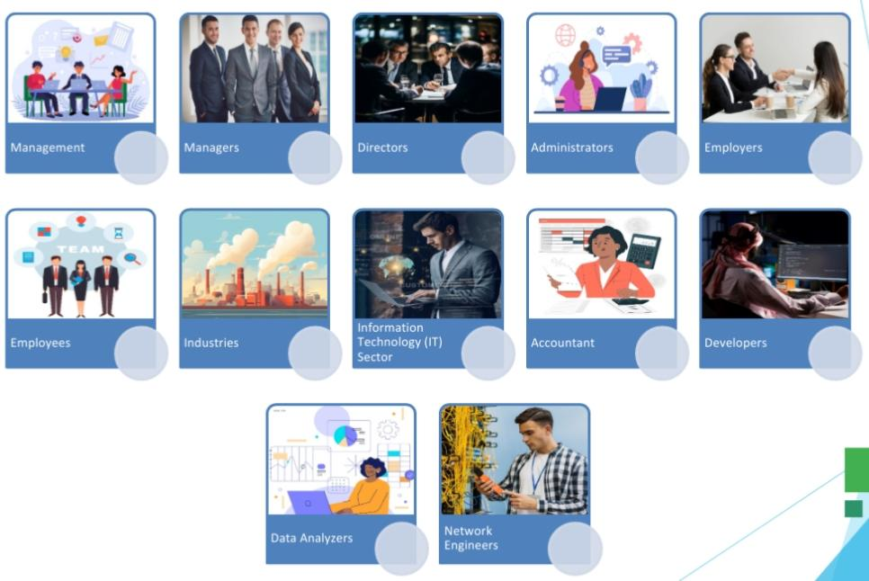

WHO ARE THE END USER

Slide 7

OUR SOLUTION AND ITS VALUE PROPOSITION
Employee ID – Sort from Smallest to Largest Conditional Formatting – Missing Values Filter – Removal of Missing Values Columns Formula – Findout Employee Performance Category Level Pivot Table – Summary of the Employees Performance Analysis Recommended Chart – Employee Performance Analysis Visualization Pie Chart – Identify the Business Unit Wise Summary Visualization

Slide 8
DATASET DESCRIPTION
Employees Database Sourced from “Kaggle” The Employees Database includes 26 Features I selected 9 Features for Employee Performance Analysis Employee ID, a Numerical Value, was sorted in Ascending Order Names were provided as First Name & Last Name Business Unit was listed in Abbreviated Form Employee Status was indicated as either Active or Terminated Voluntarily

Slide 9
DATASET DESCRIPTION
Employee Type was categorized as Part-Time, Contract, and Full-Time Employee Classification was listed as Voluntary, Involuntary, and Retirement Performance Scores were recorded as Improvement, Needs Improvement, Fully Meets Expectations, and Exceeds Expectations Current Employee Ratings were provided as Numerical Values ranging from 1 to 5 Performance Category Level was determined using a Formula

Slide 10

THE “WOW” IN SOLUTION
PERFORMANCE CATEGORY LEVEL:
= IFS(Z3>=5,” VERYHIGH”, Z3>=4,”HIGH”,Z3>=3,”MEDIUM “,Z3>2,”POOE”,Z3>1,”VERY POOR”)

Slide 11
MODELLING
Data Preparation: Gather employee performance data from multiple sources, such as performance evaluations, productivity measures, and attendance logs. Ensure the data is clean and organized, with key fields including employee names, performance ratings, departments, and review periods. Building Pivot Tables: Utilize Pivot Tables to compile and summarize performance data. Key elements include,
Rows and Columns: Organize data by categories such as employee, department, or performance period. Values: Establish calculations to assess performance metrics, such as average scores or total hours worked. Filters: Apply filters to narrow down specific data subsets, like top performers or particular departments.

Slide 12
Modelling
Analysis and Visualization: Create Pivot Charts to visually display performance trends and comparisons. Develop dashboards to provide a quick overview of key performance metrics. Insights and Recommendations: Detect patterns and outliers in employee performance data. Produce actionable insights to guide decisions on promotions, training requirements, and strategies for performance enhancement.

Slide 13
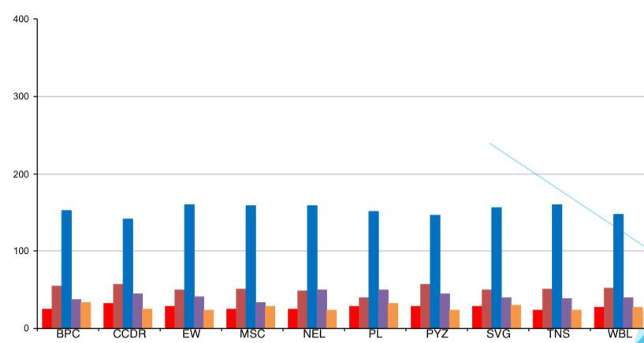
Results

Slide 14
Conclusion
Utilizing Pivot Tables in Excel for employee performance evaluation provides a robust and effective means to manage and interpret intricate data. By capitalizing on this feature, companies can convert raw performance data into valuable insights that inform strategic HR decisions. Excel Pivot Tables serve as an essential resource for employee performance evaluation, offering a simplified approach to data analysis, visualization, and informed decision-making. By adopting this technique, organizations can gain a more precise and actionable understanding of employee performance, ultimately boosting overall organizational effectiveness and employee satisfaction. Key Highlights: •Improved Data Structuring •Dynamic Evaluation •Enhanced Decision-Making •Effective Visualization •Time-Saving Efficiency

